Slide 1


Bee.deals Data Science Project
Submitted by: Boris Martzinovsky

Slide 2
Introduction
Bee.deals is an Israeli online community/forum dedicated to “consumer crowd wisdom”. Community members share deals that they found on the web, and receive comments/likes/’bought’ marks from other community members. The discussion tends to be lively and humorous, unincumbered by the heaviness of real-life identity required by similar communities on the Facebook Groups platform, while occasionally descending into flame wars and less-than-positive personal exchanges.

Slide 3
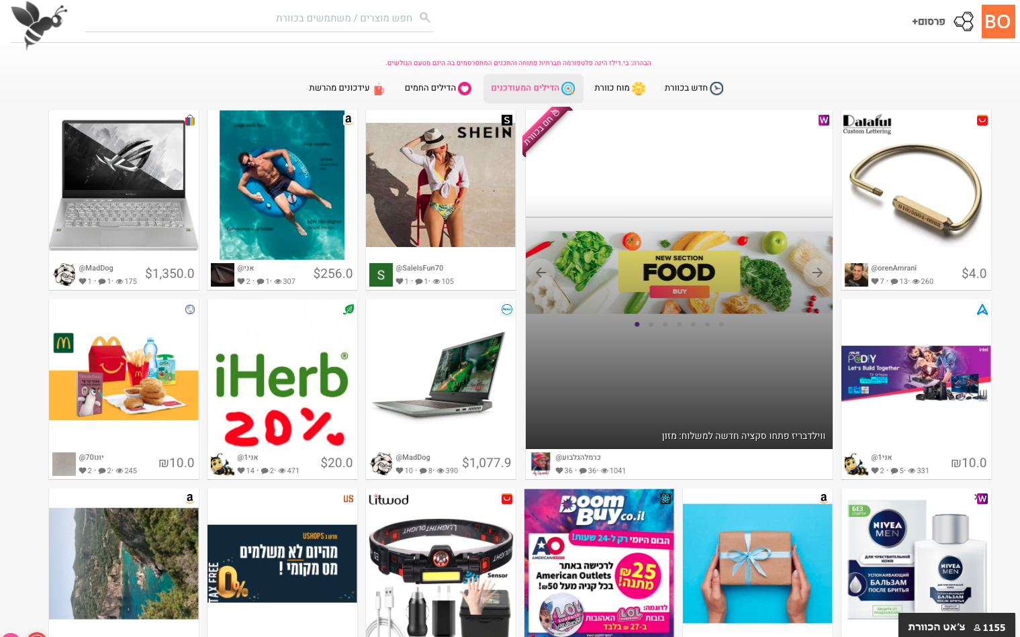
Bee.deals frontpage:

Slide 4
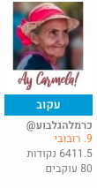
The website has a gamification mechanism rewarding users for popular content.
Points are awarded automatically by the site according to a formula that takes into account the likes/’boughts’/clicks that a user’s post generated. The user then gets promoted through a series of ‘ranks’ numbered from 1 to 10, named after bee species real and imaginary.
NewBee
מדרונית
מחושית
דבורת דבש
דַבּוּר
צרעה
דבורה קטלנית
דבורת בומבוס
רוֹבּוֹבִּי
SuperBee

Slide 5
Goals
To look for a connection between price and likes/’boughts’ – perhaps there is a normal distribution, where both 20 cents aliexpress items and premium 2000$ laptops are less popular, while reasonably priced products in the middle get traction?
Is the platform generally ‘fair’ to new users – do higher ranking users get more likes?
Are items with free shipping more popular regardless of their price? Israelis tend to really love free shipping, sometimes to the point of being almost blinded by it and disregarding the overall attractiveness of the deal.

Slide 6
Goals
Can the number of comments predict the number of likes and ‘boughts’? It would make sense that those are connected, but sometimes people like to discuss for the sake of discussion and argue for the sake of argument…
Is it possible to predict the popularity of a deal ‘naively’ – only knowing the post content/price/shipping/user rank, as if we only have the parameters of the deal at the time it was posted?

Slide 7
Data Acquisition
The site’s content is generated dynamically by an Angular front-end querying a PHP back-end. The front-end receives its’ data in JSON format and processes it to spit out the website HTML.
It would have been possible to scrape the website using a WebDriver like Selenium. We can however inspect the front-end requests sent to the back-end. Luckily, by mimicing those calls and disguising ourselves as the site front-end, we can query the back-end and use the endless scroll mechanism to fetch the JSON data of all the deals ever posted, page by page.

Slide 8
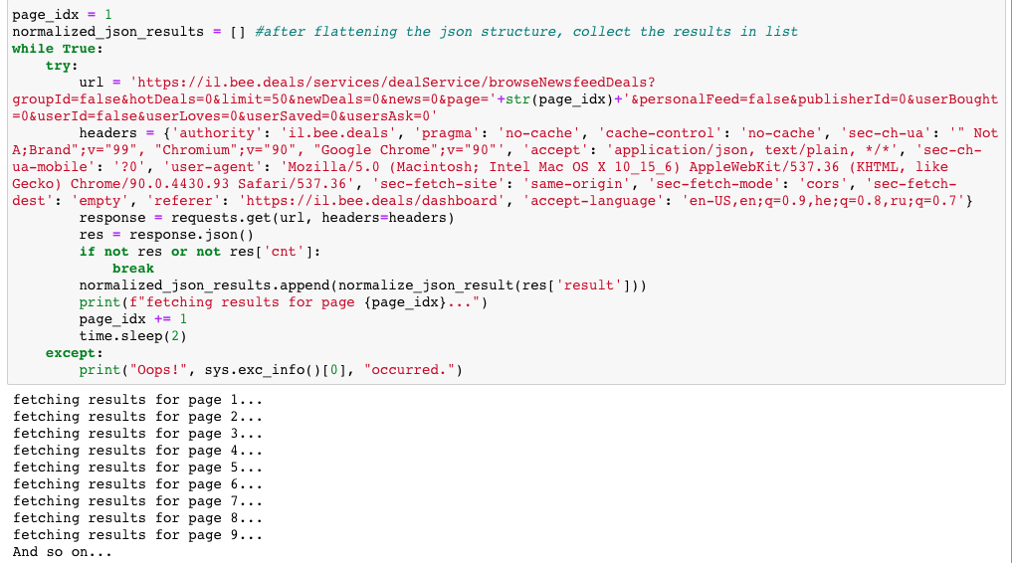
Data Acquisition

Slide 9
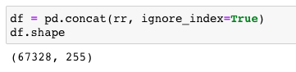
Data Acquisition
The JSON is parsed, flattened to remove the multi-level hierarchical structure, and added to a list that will be appended into a Pandas dataframe. After a few hours, we have our results.

Slide 10
Data Handling
Removing unneeded columns, e.g. a column that exists for each possible currency’s conversion rate to ILS
Removing string content from ‘user.rank’ and only leaving the number (”10. Superbee” -> 10)
Converting this and other ‘object’ type columns to numeric where applicable
The prices for each item are given in a local currency. We convert them to USD for uniformity. Same goes for shipping price.
Filling empty shipping price with 0

Slide 11
Data Handling
We also create a new ‘total_price_in_usd’ column, which holds the sum of the item price and the shipping price, after conversion to USD.
Since new posts can be added while crawling, so paged API results might contain duplicate rows. We’ll remove those as well
Some user columns contain NaN values. We’ll fill them with the median value for the respective column. Other numeric columns we fill with zeroes.
We’ll remove all columns used for internal workings of the front-end, so that only the columns that interest us will remain.

Slide 12
Extra Features
Let’s add some extra features that might help us with predictions later.
We’ll count the amount of words used in the item description, which might indicate how hard the post author worked in order to present the deal
We’ll also count the amount of images added to the post, for similar reasons
A ‘free_shipment’ column will be added, indicating whether the item is shipped for free
Another column will indicate (by checking whether the store domain ends with .il) local shipment from Israel, which usually means much shorter waiting time

Slide 13
Extra Features
Another interesting thing to consider is the sentiment score of the item description. Will more ‘positive’ verbiage get more traction? Maybe actually the negative posts will gain popularity?
Since there are no ready-made sentiment scorers for Hebrew text, we’ll first need to translate our item descriptions into English (using Google translate), and then assign sentiment scores to these translations.
We will use the (somewhat buggy, unstable and slow) google_trans_new library for the task.

Slide 14
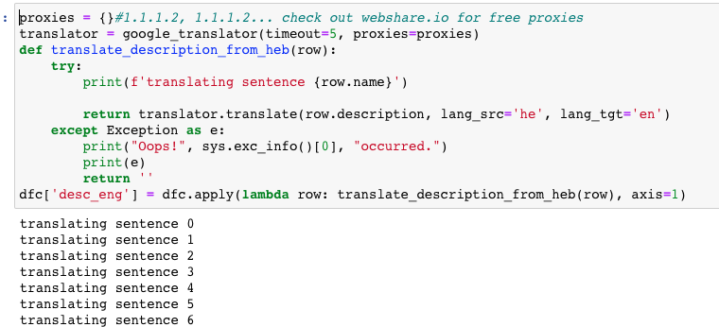
Extra Features
The library requires the use of proxies in order to avoid Google Translate API abuse errors.

Slide 15
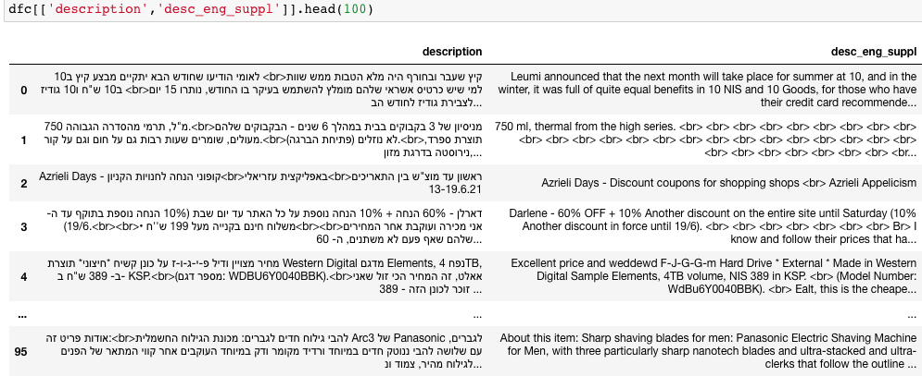
Extra Features
After quite a while, all translations are finally obtained.

Slide 16
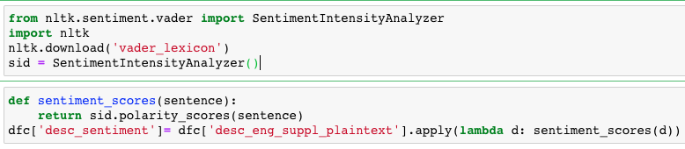
Extra Features
We’ll remove HTML tags from the descriptions using Beautiful Soup. Now we can run our sentiment scorer from the Vader library.
Some tweaking is needed to split the sentiment scores dictionary into columns.

Slide 17
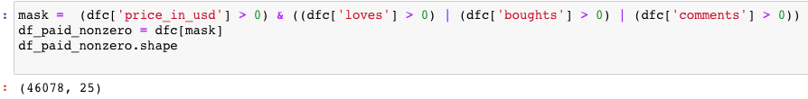
Data Handling
Finally, we’ll apply a mask to remove rows that are uninteresting to us:
Rows where price is 0 - mostly used for gathering advice and off-topic ranting
Rows where there are no likes, ‘bought’s or comments – we’d like to focus on items that got at least a little bit of traction, not ‘shouting out into the void’

Slide 18
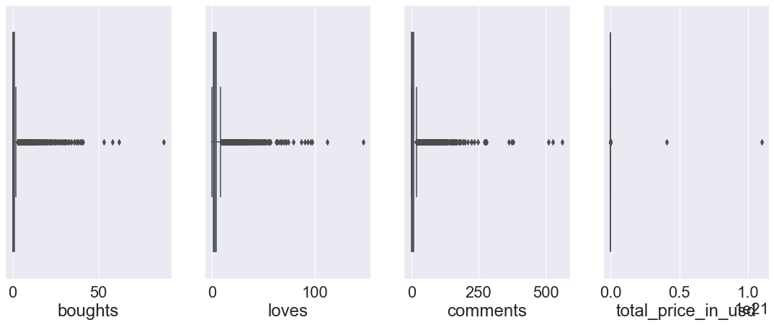
Data Handling
Using box plots on likes, boughts, comments and total price comments, we can see that many outliers exist.

Slide 19
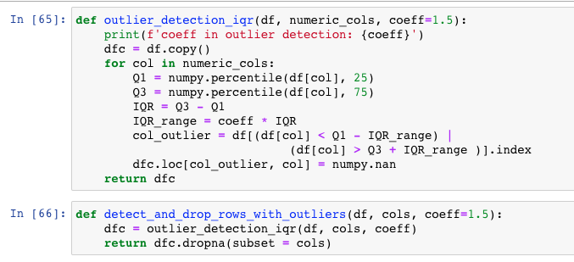
Data Handling
However, later we’ll see that removing outliers only helps us on price columns. On other columns, removing outliers is detrimental to the success of linear regression. So we’ll detect and remove the outliers for price columns.

Slide 20
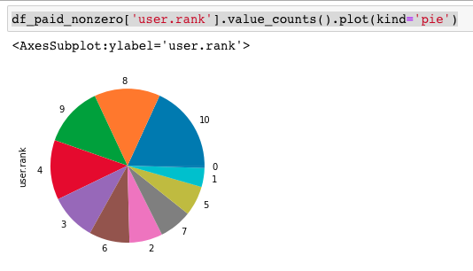
Data Analysis
Let’s check how are the different user ranks distributed
We can see that the top ranks are more populous, but overall the distribution is rather uniform

Slide 21
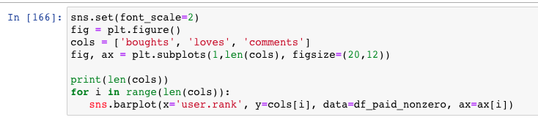
Data Analysis
On the next slide, we’ll see how are likes/’boughts’/comments distributed by user rank.
Overall, the distribution is pretty ‘democratic’, and lower-rank users get their share of attention. It seems that ‘likes’ (loves) are most directly correlated with rank.

Slide 22
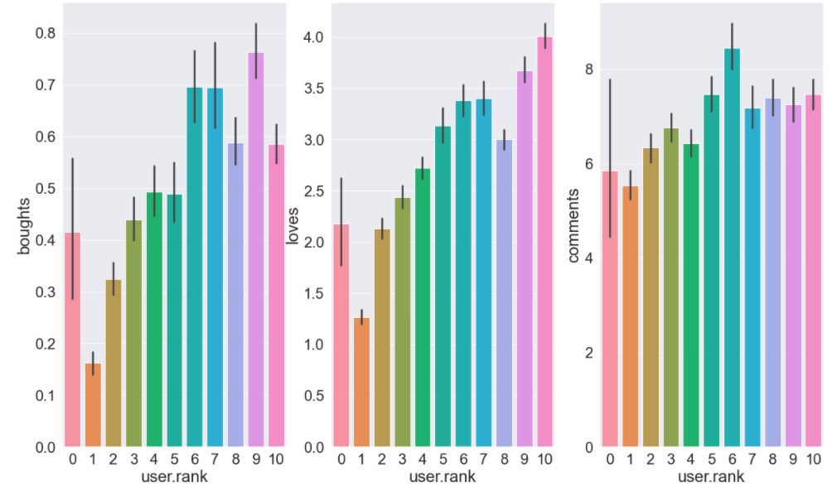
Data Analysis

Slide 23
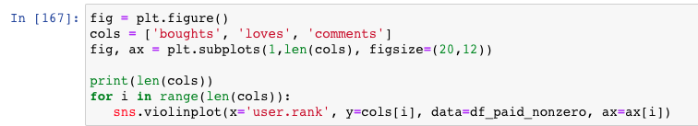
Data Analysis
Using violin plots for the same columns, we can see that our violins look more like balalaikas – very dense at the bottom near zero. This is not an optimistic sign – looks like our data is not very ‘meaty’…

Slide 24
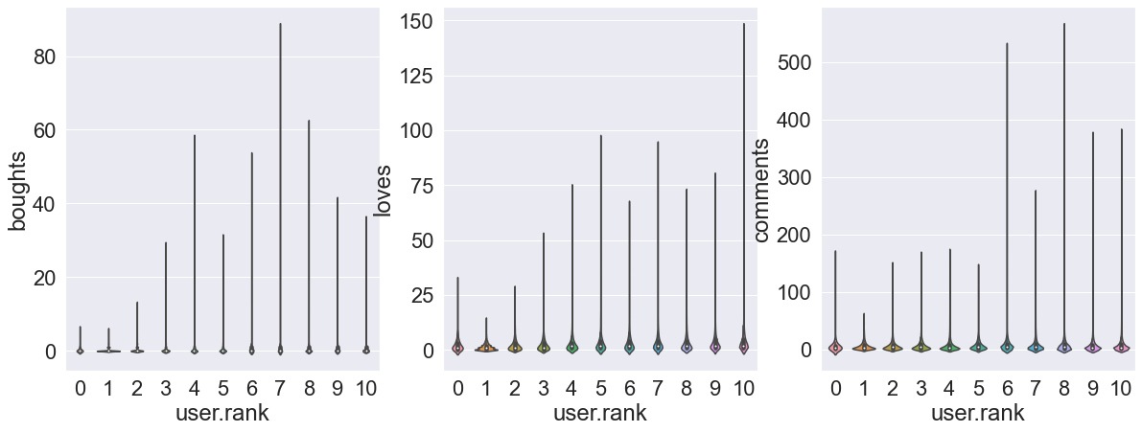
Data Analysis

Slide 25
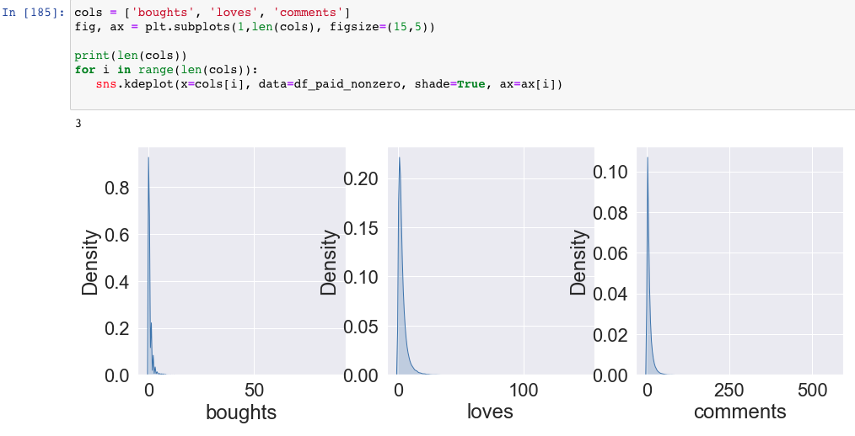
Data Analysis
Kernel Density plot suggests the same

Slide 26
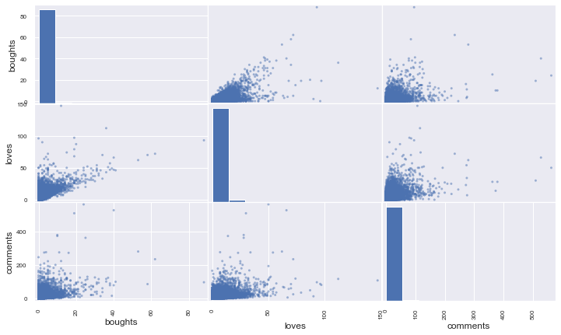
Data Analysis
Let’s examine the scatter plot matrix for our target columns – loves, boughts and comments.
Looks like some correlation exists, although there’s much noise.
Next, let’s look at the scatter plot matrix for all columns.

Slide 27
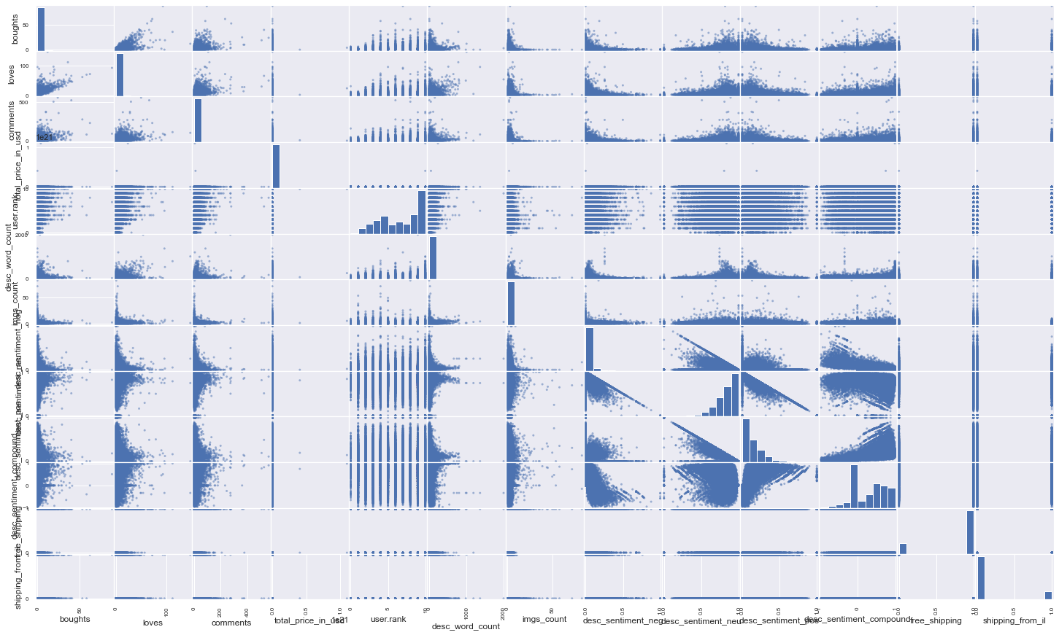
Data Analysis
Click here for full resolution image
This doesn’t look promising– while our target columns seem to be correlated among themselves, there’s not much connection between target columns and other columns.
Various sentiment columns are naturally correlated to one another as well.
Let’s look at the Pearson coeficients table.

Slide 28
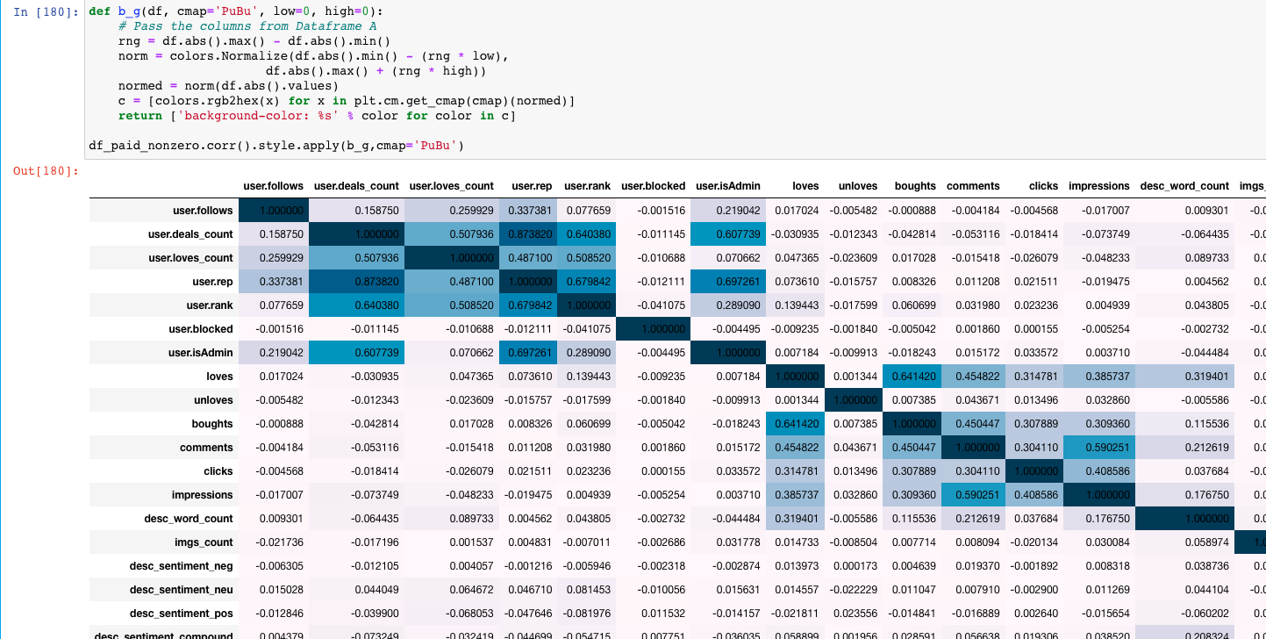
Data Analysis
We added a method to color the coefficients according to their absolute values

Slide 29
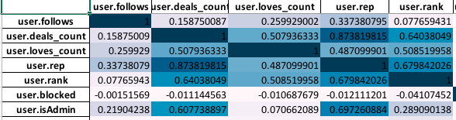
Data Analysis
Looking at the correlation matrix in detail, we can see that there are clusters of correlated columns
The first cluster is user columns – correlations here make sense and are to be expected. User rank and user reputation go up when a user’s deals count is high, admins tend to post a lot of deals etc.

Slide 30
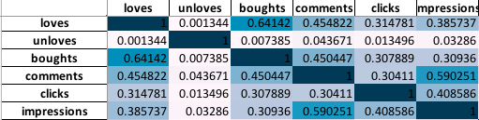
Data Analysis
The second cluster is our target columns – loveds, boughts, comments (also clicks and impressions)
This makes sense – whoever bought an item has a higher chance of also ‘loving’ it. We can also notice that comments are somewhat correlated with loves and boughts.

Slide 31
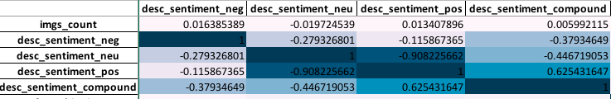
Data Analysis
The third cluster consists of various sentiment scores.
This is an artifact of sentiment scorer’s way of operating, and is not too interesting.

Slide 32
Data Analysis
Unfortunately, all other correlations are pretty weak. Still some insights can be derived.
Amount of words in description is somewhat correlated to our target columns:
Free shipping column is somewhat inversely correlated to user deals count, rank and reputation. Higher ranked users tend to recommend items without free shipping:

Slide 33
Machine Learning
We will try to predict the values of our target columns using Linear Regression.
Ideally we would like to predict a target column without using any other target column - e.g. to predict ‘loves’ without using ‘boughts’, clicks and impressions.
Since the price columns vary quite widely in their values, it’s difficult to choose the best coefficient for our IQR outlier detection, so we’ll test multiple possible IQR coefficients and see which one will give us the best R^2 score after linear regression.

Slide 34
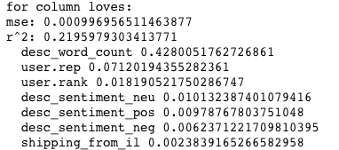
Machine Learning
Applying linear regression, the results are quite disappointing. For the best IQR coefficient for price columns (=5), we only get R^2 score of 0.21 when predicting ‘loves’ column. With other columns the R^2 scores hover around zero.
Since we normalized our dataset, we can tell which columns contributed most to the prediction by looking at their coeffs returned by Linear Regression.
Interestingly, the synthetic “description word count” column that we added ends up being the largest contributor to the prediction. The sentiment columns have almost no effect, and neither do the price and shipping columns.

Slide 35
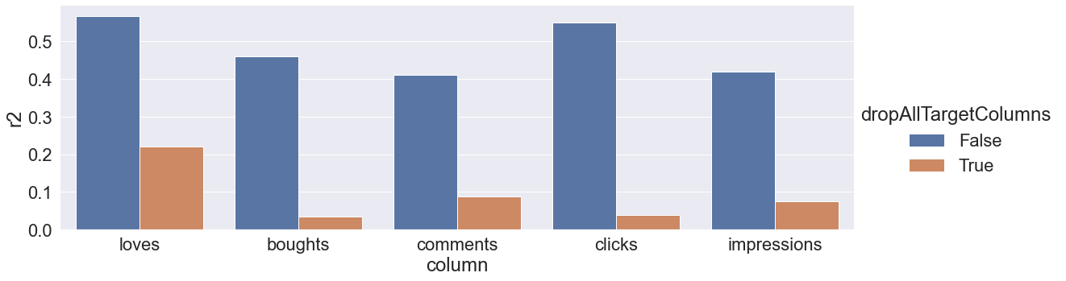
Machine Learning
So, in the naive case (when predicting a single target column after dropping all other target columns), we are far from success. In the non-naive case , results are somewhat better:

Slide 36
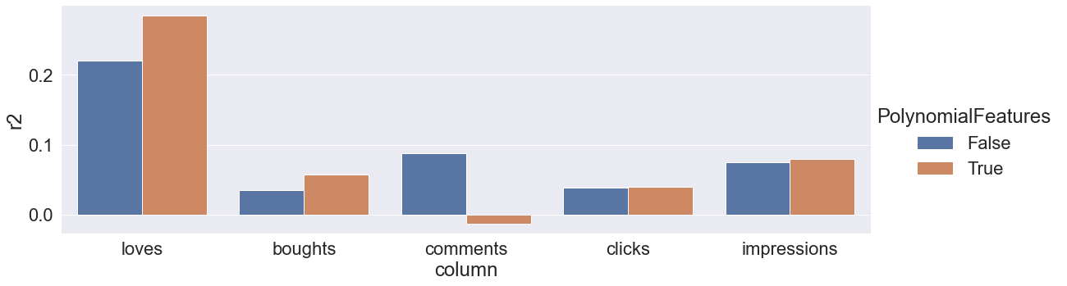
Machine Learning
From the beginning we’ve seen that our data is poor in linear correlations, so it might be a good idea to improve the prediction by using Polynomial Features. This indeed has some beneficial effect (tho actually adverse on the ‘comments’ column):

Slide 37
Machine Learning
Since our prediction with Linear Regression was disappointing, we can try other regressors – using the models we learned about, but utilizing not their classifiers but their regressors. We’ll be looking at
KNN
Decision Tree / Random Forest
Bayesian Ridge
RidgeCV
Ridge

Slide 38
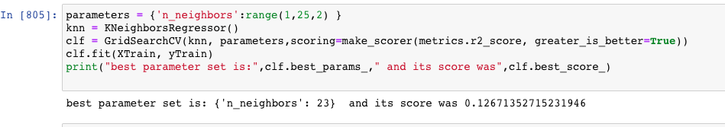
Machine Learning
For KNN, we’ll use Grid Search Cross Validation to find the best hyper-parameters, in the initial range of 1 to 23
This takes a lot ot of time, and our best n_neighbors parameter was the highest one we checked, so we forego the Cross Validation and check possible n_neighbors values directly. Our dataframe has 40k rows, so we’ll go up to n_neighbors = 200, which is the square root of 40k.

Slide 39
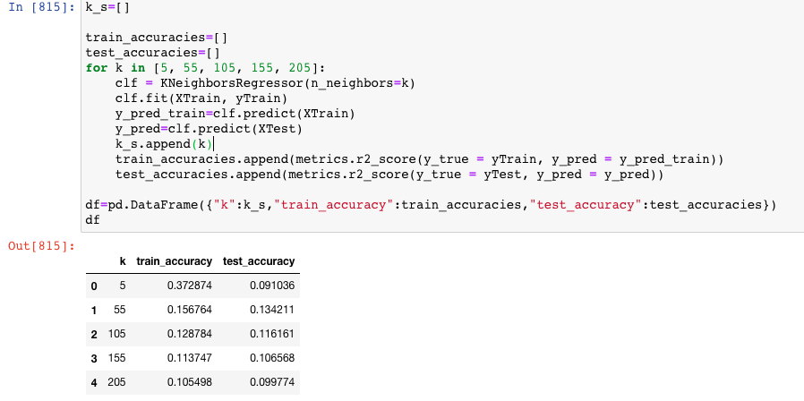
Machine Learning
The best value seems to be somewhere in the lower range, so we’ll try there, with a bit more granularity.

Slide 40
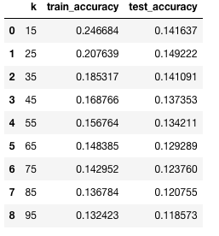
Machine Learning
Eventually, for n_neighbors = 25 we get the maximum 0.149 r^2 score, which is lower than the score we got with linear regression.

Slide 41
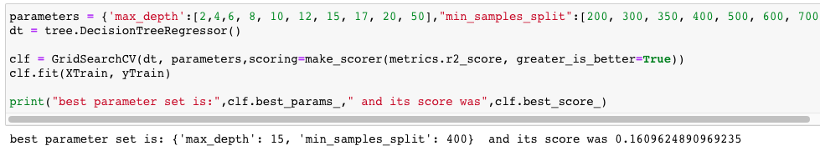
Machine Learning
Next we’ll try the Decision Tree Regressor.
Using GridSearchCV to find optimal hyperparameters values, we find that the best possible score is 0.16, which is better than KNN but still lower than linear regression.

Slide 42
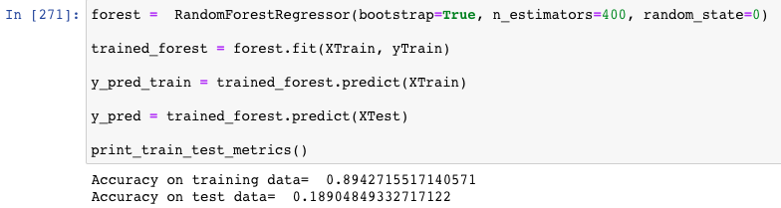
Machine Learning
Could the Descision Tree prediction be improved by Random Forest?
By uneducated guessing we find that best results are provided when n_estimators=400
Still, accuracy remains unimpressive.

Slide 43
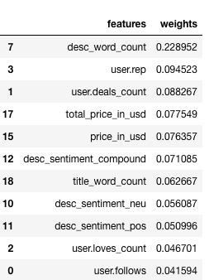
Machine Learning
We can check which of our features carried the most weight in the Random Forest model.
Similarly to Linear Regression, most important feature
Is the number of words in the description.

Slide 44
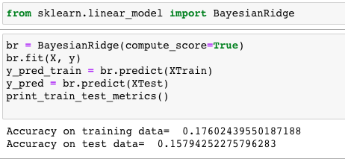
Machine Learning
Since some of our features (the user columns and the sentiment ones) are correlated among themselves, it might be worthwile to apply RIDGE type regressions.
For Bayesian Ridge,
r^2 is 0.158

Slide 45
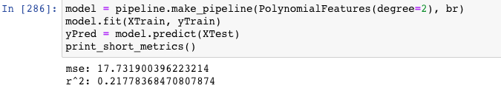
Machine Learning
For a small experiment, since the RIDGE models are rather fast to train, we can check whether applying Polynomial Features improves prediction quality.
r^2 score is now at 0.218, so Polynomial Features do help here as well.

Slide 46
Machine Learning
Ridge and RIdgeCV from SKLearn’s linear_model library give us pretty similar results, with the highest score of 0.222 received by RidgeCV after Polynomial Features applied.
Ultimately, linear regression with polynomial features applied yields better results than other regressors.

Slide 47
Conclusions
The bee.deals platform is pretty democratic – lower ranked users have almost the same chances for their posts to become popular as higher ranked users
There is no ‘sweet spot’ for the price of the item posted for the item to gain traction
Free shipping is not a predictor for item popularity. Curiously though, higher ranked users tend to recommend items with more expensive shipping.
Length of item description does count – one should take the time to ‘invest’ in the post he/she is writing

Slide 48
Conclusions
We can’t predict a post’s popularity ‘naively’, only knowing what’s known at the time the post is added – it’s verbal content, price/shipping and it’s author’s characteristics
However we can somewhat reliably predict a single dimension of a post’s popularity (e.g. number of likes) when we take into account other dimensions of popularity , such as it’s ‘boughts’, clicks and impressions.

